Slide 1
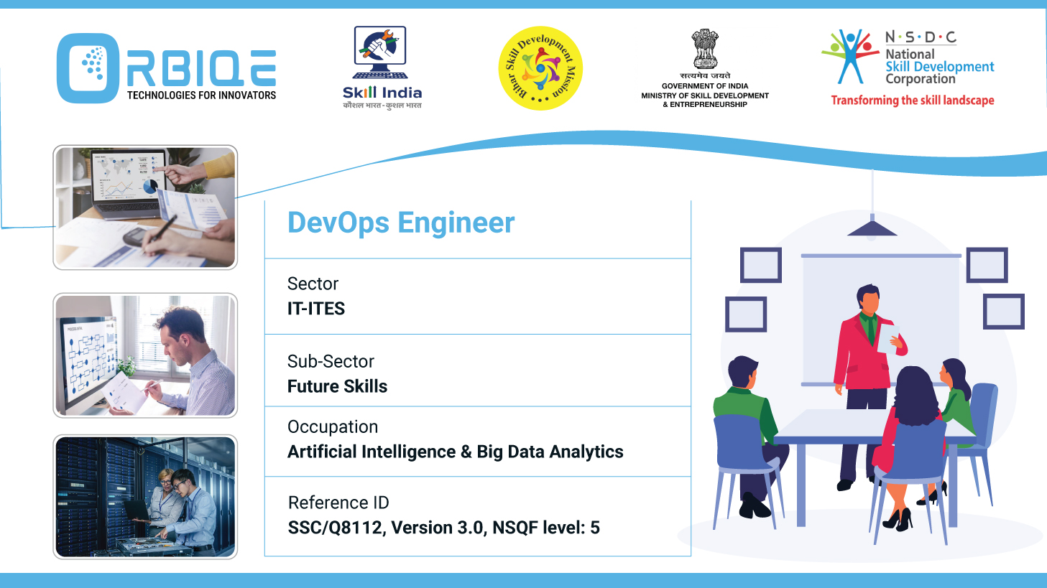
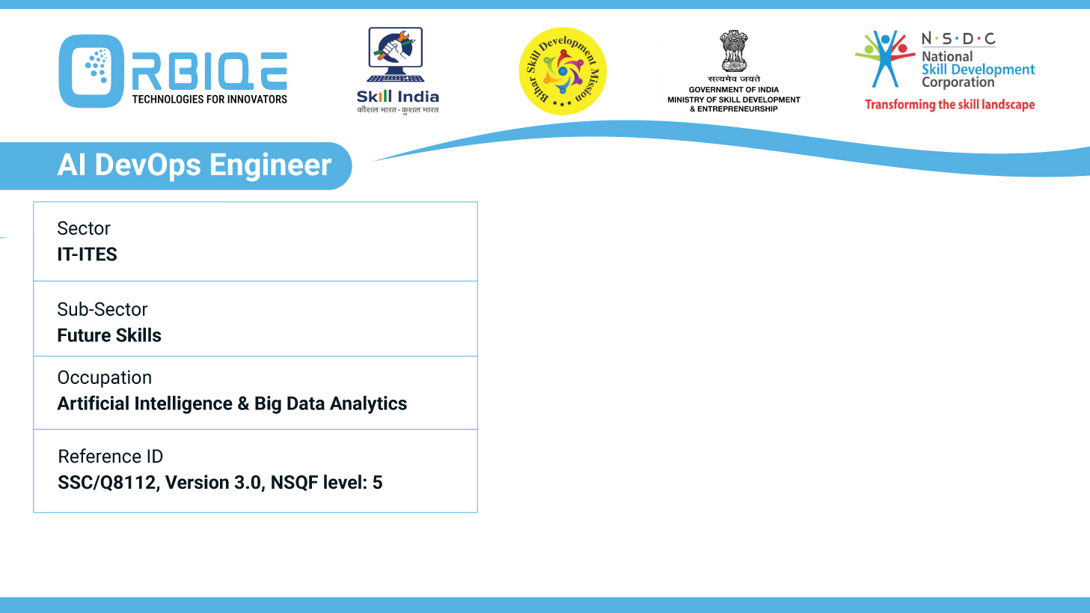
Name- Krishna Kant Dubey

Slide 2

Application Release Automation with Tools like Build Master

Slide 3
Agenda
Leverage tools like Build Master for automating the release process
Deployment
Configuration management
Rollback capabilities

Slide 4
Leverage tools

Slide 5
Deployment

Slide 6
Configuration management

Slide 7
Rollback capabilities

Slide 8
Thank You

